Slide 1
Effects & complications of stones :
I : Gall bladder : 1) Silent, asymptomatic (mostly)
2) Dyspepsia, Flatulence, Food intolerance (Fat)
3) Biliary colic
4) Cholecystitis (acute and chronic)
5) Fistula….leading to Mirizzi syndrom (less than 0.1%)
6) Mucocele.
7) Empyema of gall bladder
8) Gangrene & perforation
9) Carcinoma of gall bladder.
II : Bile ducts : 1- Jaundice
2- Acute Cholangitis
3- Acute pancreatitis
III : Intestine : intestinal obstruction ( gall stone ileus ) .

Slide 2
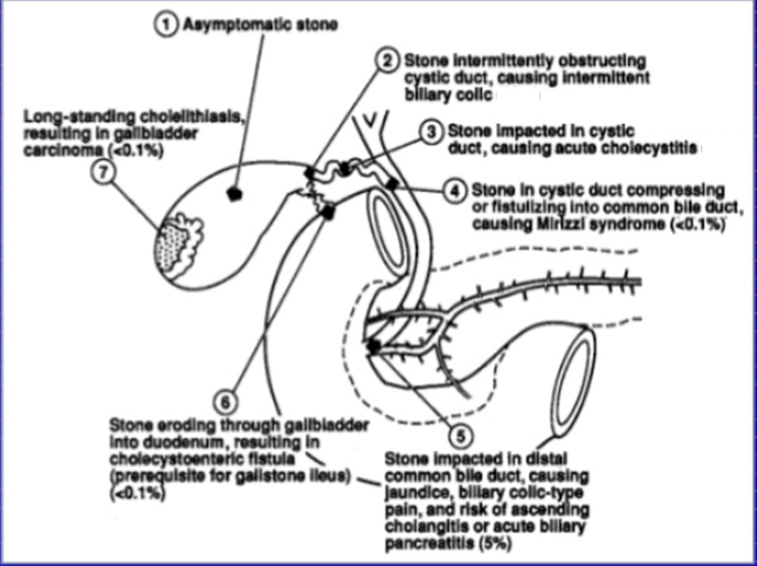
+ and flatulent dyspepsia
+then chronic cholecystitis
8.Mucocele 9. Empyema
10. Gangrene and perforation

Slide 3
Outcome of Gall Stone | Clinical Features
Silent | Most of patients , Asymptomatic
Flatulant Dyspepsia | Hx: Dyspepsia; R hypochondrail Pain or epigastric pain (more often dull and constant) + flatulence+ intolerance of Fatty food
Biliary colic | 10-20% of patients of gall stone, Hx: Several episodes of pain which is sever (minutes-hours)+ nausea &vomiting for few weeks –then period of relief for few months as the stone dis-impacted back into gall bladder Ex: negative Murphy’s sign + No fever UlS: no signs of acute cholecystitis but there is stones Blood invest.: no significant change in laboratory data (may be slight rise in liver enzyme and bilirubin)
Acute cholecystitis | Hx: R hypo&/ or epigastric pain more sever Ex: Tenderness+ Murphy’s sign positive+ low grade fever UlS Scan: shows signs of acute cholecystitis: distended gall b.+ presence of stones+ thickened wall of gall bladder+ pericholecystic fluid collection Blood invest.: leukocytosis +moderate elevation in LFT
Empyema of Gall Bladder | Same of acute cholecystitis + history of acute attack that has not relieved + more pain+ More tenderness+ more fever+ inc in pulse rate+ might be palpable mass in R hypochondrial region (gall bladder surrounded by omentum)
Perforation | Sign and symptoms of peritonitis usuall localized.
Chronic Cholecystitis | Hx: History of acute attack that has already been relieved+ pain less in severity and frequency + might be flatulent dyspepsia+ nausea and vomiting Ex: No fever or tenderness or Murphy’s sign negative (shrinkage gall bladder) U/S: shrinkage gall bladder+ presence of g. stone+ No sign of acute Blood investing.: Often Normal

Slide 4
Cholecystitis :
Acute & 2) chronic
Calculous 85 – 95 %
Acalculous 5 – 15 %
Acute :
Inflammation of gall bladder wall .
M.O. :
1- E.coli . 2- klebsiella . 3- streptococcus faecalis .4- bacteroid .
5- clostridia & typhoid (uncommon & serious).
Causes of acute cholecystitis :
1-Stone in 90% impacted in Hartmann’s pouch or obstructing cystic duct .
2- Stasis 3- Pancreatic juice reflux 4 – CBD stone .
5- Bacteremia .
6 – Vascular effect of → D.M.
→ sickle
→ hypertension
→ collagen disease
cystic artery thrombosis → ischemia .

Slide 5
Clinical features of acute cholecystitis :
1- sudden onset .
2- 30 – 70 years & > 60 years 25% - 35% .
3- White caucasian > black people .
4- Heavy fatty meal .
5- Pain (colicky).
6- Nausea & vomitting .
7- Fever > 38̊ C .
8- Boas’s sign .
9- Jaundice ?
10- Murphy sign .
11- Tenderness & rigidity .
12- Palpable tender mass .
DDx :
1- Appendicitis . 2- Perforated peptic ulcer .
3- Acute Rt. Pyelonephritis 4- Liver abscess .
5- Rt. Lower lobar pneumonia. 6- Hepatitis
7- Pancreatitis 8- Herbes zoster .
9- Myocardial infarction .

Slide 6
The sequelae of attack :
1- Resolution ; disimpaction of the stone & drainage , slipping back of the stone.
2- Impacted stone persist → gangrene , mucocele , empyema .
3- Perforation .
4- Chronic .
Dx:.1- ultrasound .
2- Radio isotop scan ( HIDA ) .
3- L.F.T.
4- WBC ___ leucocytosis .
Treatment :
A- Conservative Rx followed by laparoscopic Cholecystectomy (after 6-8 weeks).
B- Laparoscopic Cholecystectomy .
A- Conservative :
90% of cases the symptoms subside.
1- N.G. tube & nil per mouth .
2- Antibiotics e.g.; cefazolin , Cefotaxim , gentamicin .
3- Analgesia & antispasmatic .

Slide 7
B- Cholecystoctomy : → Early 2 – 3 – 5 days .
→ Delayed ˃ 6 weeks .
Laproscopic
rarely Open (if laparoscopic is not accessible or in case of conversion)
N.B. : Conversion rate in acute cholecystitis more than in elective ( delayed ) but still conversion not failure of laparoscopic cholecystectomy
Chronic cholycystitis :
Thickened fibrotic wall of G.B. with stone(s) .
Symptoms :
1- Pain : episodes of Rt. hypochondrial pain of varying severity & interval ( 3 – 12 hours) after .
2- Flatulent dyspepsia , fullness , belching , heartburn & distension .
3- nausea & vomiting .
Dx: As acute .
Rx: Cholecystectomy

Slide 8
.
Saint triad :
1- Gall stone(s) .
2- Diverticulosis .
3- Hiatus hernia .
It is important to find which one is the cause for dyspepsia
Post cholecystoctomy complications :
1- Bleeding .
2- Jaundice .
3- Adjacent organs injury.
4- Biliary leak → fistula ; due to : a) Slipped ligature
b) Accessory duct .
c) CBD. Injury or ischemia .
d) Mirizzi syndrome .
5- Post cholecystectomy syndrome.
Indications of cholecystoctomy.
1- Symptomatic gall stones.
2- Asymptomatic gall stone as prophylactic cholecystectomy (controversial) .

Slide 9
:

Slide 10
Indications of choledochotomy at cholecystectomy :
1- Stone in CBD.
2- Jaundice now or history .
3- Dilated CBD. ˃ 10 mm.
4- ↑ alkaline phosphatase .
5- Wide cystic duct & multiple small gall stones .
Any way the trend now in this case is to continue in laparoscopic cholecystectomy and after operation send the patient to ERCP to remove the CBD stone

Slide 11
Treatment :
1- ERCP & sphineterotomy .
2- Choledochotomy :
A- Supraduodenal choledochotomy stone removal and then T. tube or choledocho-duodenostomy .
B- Transduodenal sphineterotomy & stone extraction .

Slide 12
Treatment :
Cholecystectomy + excision of gall bladder liver bed + Hilar lymphadenectomy .
Prognosis :
Poor.
90% will die in one year .
2–5% is 5 year survival .

